Slide 1

SATELLITES, DISTANCE APPROXIMATION, FEASIBILITY TEST, COLLISION DETECTION, SATELLITE HARDWARE, ALGORITHMS IMPLEMENTATION
Capstone Project Phase B
24-2-D-29
Supervisor: Mr. Ilya Zeldner
Shir Cohen 316216340
Yotam Aharon 208608448

Slide 2
Overview
Introduction 3-4
Background 5-7
Algorithms for Collision Detection 8-10
Goals 11
Solution 12-33
Challenges 34
User Interface 35-38

Slide 3
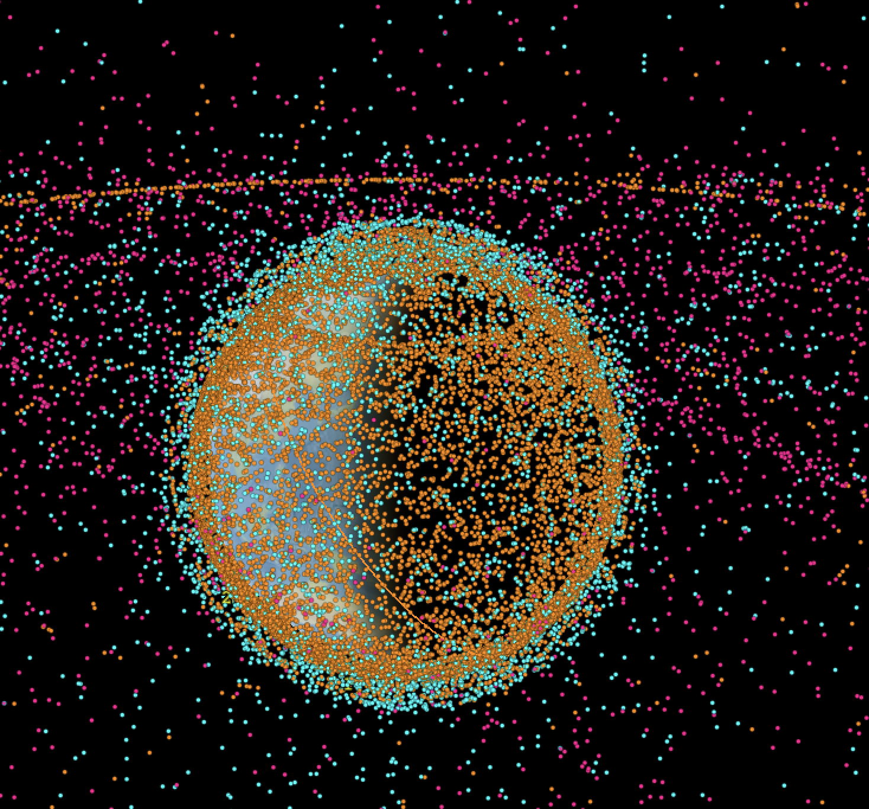
Introduction
Active\Old Satellites, Space debris 13/03/25
Satellites
Space debris
Finding possible collisions
Autonomous satellite.
Active satellite
Inactive satellite
Rocket body
Space debris Uncategorized
http://astria.tacc.utexas.edu/AstriaGraph/
1
2
3
4
5
6
7
8
Introduction
Background
Algorithms
Expected results
Solution
Expected Challenges
Verification
plan
User interface
3

Slide 4
Introduction
Build on prior work titled "Feasibility Analysis and Performance Testing of Collision Detection Algorithms for Satellites”.
Transition from theoretical to practical implementation, focusing on testing algorithms on satellite On-Board Computers (OBC)​.
1
2
3
4
5
6
7
8
Introduction
Background
Algorithms
Goals
Solution
Expected Challenges
Verification
plan
User interface
4

Slide 5
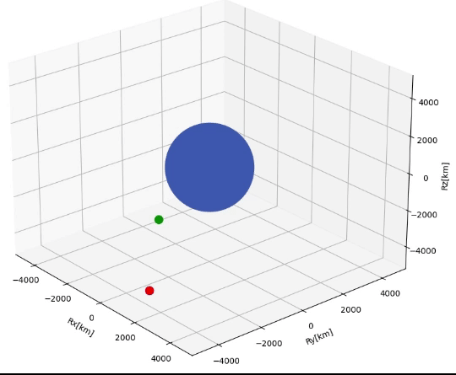
Background
Finding the future orbit
Propagators
SGP4 Standard General Perturbations Satellite Orbit Model 4
LEMUR2[green] – COSMOS[blue]
1
2
3
4
5
6
7
8
Introduction
Background
Algorithms
Goals
Solution
Challenges
Verification & Testing System
User interface
5

Slide 6
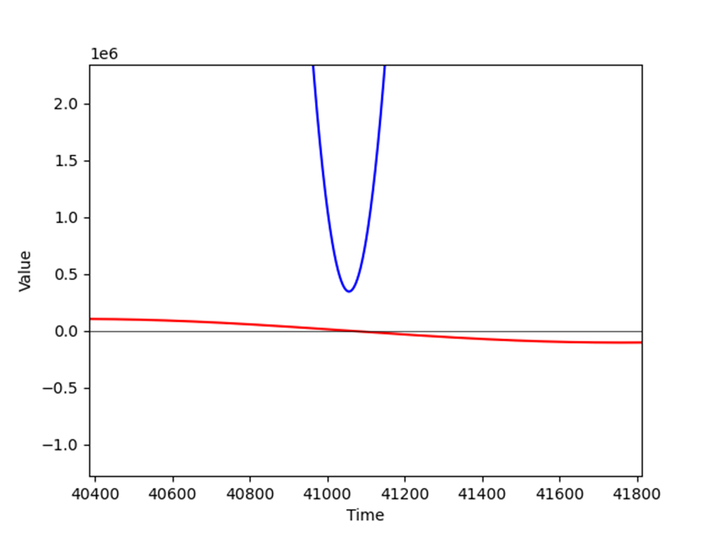
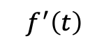
Background
Graph 1, relative distance and derivative over time
$$f^{′}\left(t\right)=2{r′}_{relative}∙r_{relative}= 2v_{relative}∙r_{relative}$$
${ f}^{′}\left(t\right)$
– blue, - red
1
2
3
4
5
6
7
8
Introduction
Background
Algorithms
Goals
Solution
Challenges
Verification
plan
User interface
6

Slide 7
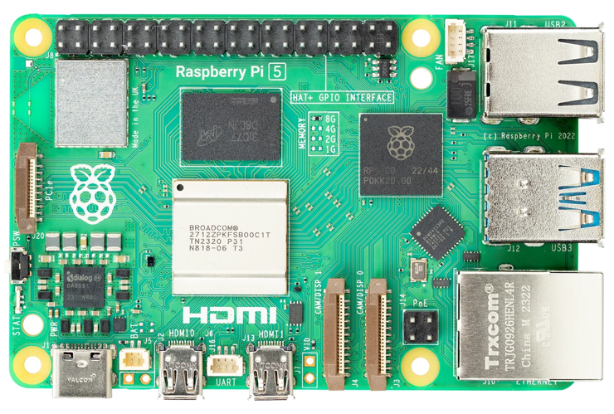
Background – Raspberry Pi 5
Processor: ARM Cortex-A76 for real-time collision detection.
Memory: Up to 16GB RAM for high-speed computations.
OS: Linux-based for flexible development and optimization.
Connectivity: Gigabit Ethernet & PCIe for reliable data transfer.
Raspberry Pi 5 Onboard Computer Front view
Processor: Broadcom BCM2712, Quad-core ARM Cortex-A76, 2.4GHz
RAM: 8GB LPDDR4X-4267
Power: Estimated between 3.5W (idle) and 7.6W (under load)
Cost: $80 USD.
1
2
3
4
5
6
7
8
Introduction
Background
Algorithms
Goals
Solution
Challenges
Verification
plan
User interface
7

Slide 8
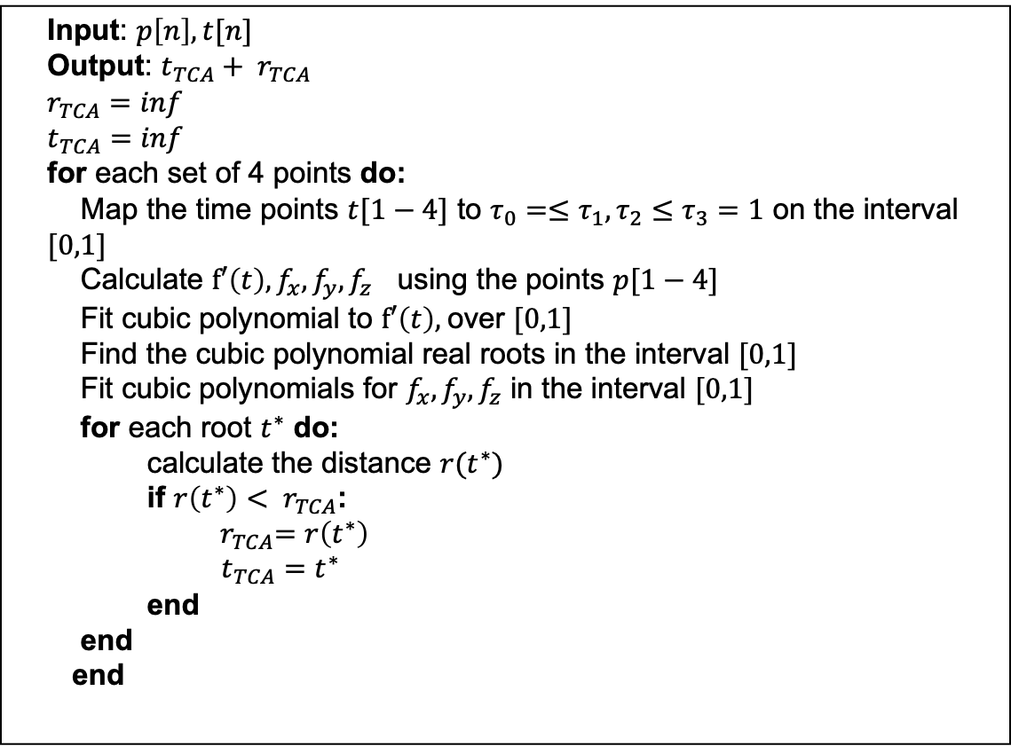
Algorithms
Input: $p\left[n\right],t[n]$
Output: $t_{TCA}+ r_{TCA}$
$$r_{TCA}=inf$$
$$t_{TCA}=inf$$
for each set of 4 points do:
Map the time points $t[1−4]$ to $τ_{0}=≤τ_{1},τ_{2}≤τ_{3}=1$ on the interval $[0,1]$
Calculate $f′\left(t\right),f_{x},f_{y},f_{z}$ using the points $p[1−4]$
Fit cubic polynomial to $f′\left(t\right),$over $[0,1]$
Find the cubic polynomial real roots in the interval $[0,1]$
Fit cubic polynomials for $f_{x},f_{y},f_{z}$ in the interval $[0,1]$
for each root $t^{∗}$ do:
calculate the distance $r(t^{∗})$
if ${r\left(t^{∗}\right)< r}_{TCA}$:
${ r}_{TCA}=r\left(t^{∗}\right)$
$t_{TCA}=t^{∗}$
end
end
end
ANCAS - Alfano Negron Close Approach Software
Cubic polynomial using 4 points
Roots: solving a 3rd degree equation
1
2
3
4
5
6
7
8
Introduction
Background
Algorithms
Goals
Solution
Challenges
Verification & Testing System
User interface
8

Slide 9
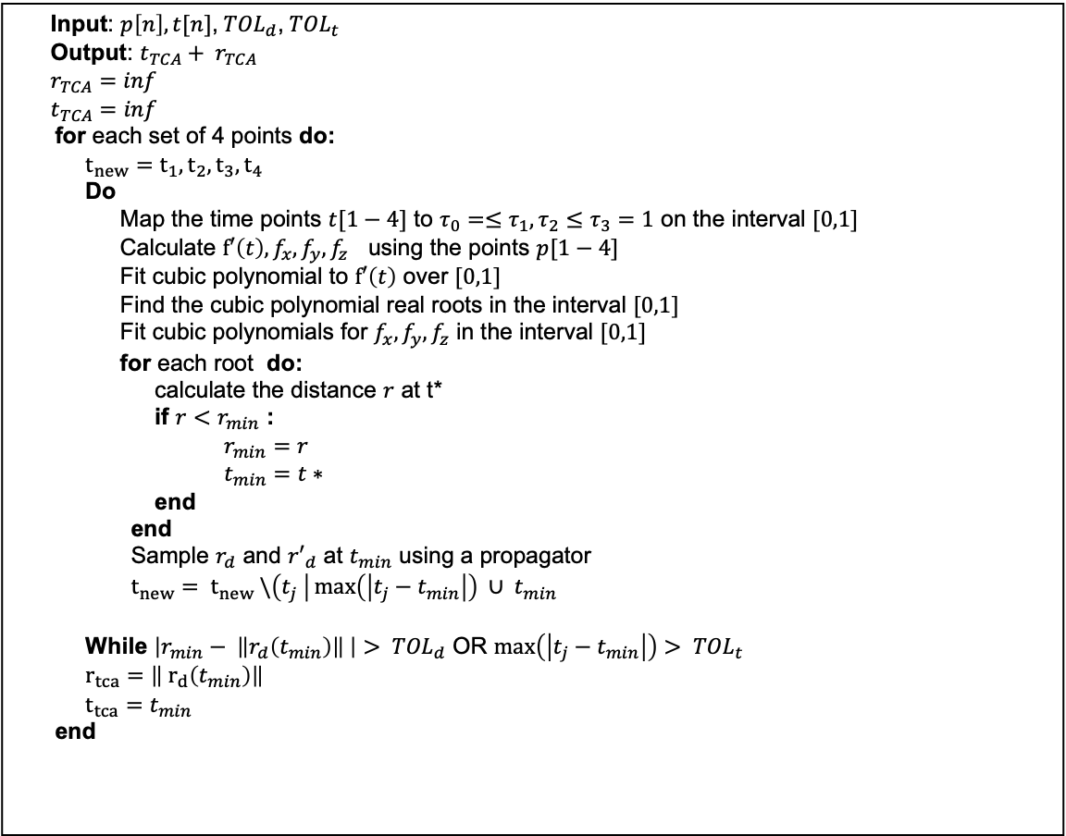
Algorithms
Input: $p\left[n\right],t[n]$, ${TOL}_{d}$, ${TOL}_{t}$
Output: $t_{TCA}+ r_{TCA}$
$$r_{TCA}=inf$$
$$t_{TCA}=inf$$
for each set of 4 points do:
$$t_{new}=t_{1},t_{2},t_{3},t_{4}$$
Do
Map the time points $t[1−4]$ to $τ_{0}=≤τ_{1},τ_{2}≤τ_{3}=1$ on the interval $[0,1]$
Calculate $f′\left(t\right),f_{x},f_{y},f_{z}$ using the points $p[1−4]$
Fit cubic polynomial to $f′\left(t\right)$ over $[0,1]$
Find the cubic polynomial real roots in the interval $[0,1]$
Fit cubic polynomials for $f_{x},f_{y},f_{z}$ in the interval $[0,1]$
for each root do:
calculate the distance $r$ at t*
if $r<r_{min}$ :
$r_{min}=r$
$t_{min}=t∗$
end
end
Sample $r_{d}$ and ${r′}_{d}$ at $t_{min}$ using a propagator
$t_{new}= t_{new} \backslash \left(t_{j} \right|\max\left(\left|t_{j}−t_{min}\right|\right) ∪ t_{min}$
While $\left|r_{min}− \left\|r_{d}\left(t_{min}\right)\right\| \right|> {TOL}_{d}$ OR $\max\left(\left|t_{j}−t_{min}\right|\right)> {TOL}_{t}$
$r_{tca}=\left\| r_{d}\left(t_{min}\right)\right\|$
$t_{tca}=t_{min}$
end
SBO-ANCAS - Alfano Negron Close Approach Software
Cubic polynomial using 4 points
But uses additional points to get better results
Tolerance in time and tolerance in distance
Roots: solving a 3rd degree equation
1
2
3
4
5
6
7
8
Introduction
Background
Algorithms
Goals
Solution
Challenges
Verification & Testing System
User interface
9

Slide 10
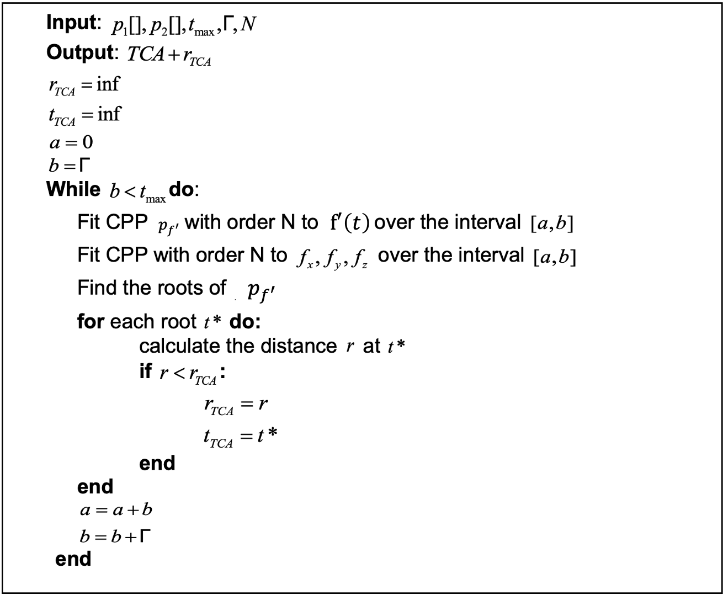
Algorithms
CATCH - Conjunction Assessment Through Chebyshev Polynomials
Using Chebyshev Proxy Polynomials
N degree polynomial using N+1 points
Roots: finding NxN matrix eigen values
1
2
3
4
5
6
7
8
Introduction
Background
Algorithms
Goals
Solution
Challenges
Verification & Testing System
User interface
10

Slide 11

Goals
Implementing and Deploying the Algorithms
Creating a Testing System
A comprehensive set of experimental results, derived from testing a variety of input types, that will either confirm or refute the feasibility of executing TCA calculations on the satellite's OBC.
1
2
3
4
5
6
7
8
Background
Algorithms
Goals
Solution
Challenges
Verification & Testing System
User interface
11
Introduction
11

Slide 12



Development Tools - Programming Languages
C++: Chosen for both Tested OBC App and Testing Station App due to efficiency, OOP structure, and compatibility with constrained hardware.
Blazor (C#): Used for GUI development for ease of integration and modern web-based interface.
1
2
3
4
5
6
7
8
Introduction
Background
Algorithms
Goals
Solution
Challenges
Verification & Testing System
User interface
12

Slide 13

Development Tools - External Libraries
Eigen: Used for eigenvalue calculations in CATCH’s root-finding algorithm, optimized for low memory usage.
INIH: Lightweight INI file reader for handling configuration files in both applications.
SQLite3: Database solution for local storage, optimized for embedded systems.
SGP4: Satellite orbit propagator used for test data generation and SBO-ANCAS calculations.
1
2
3
4
5
6
7
8
Introduction
Background
Algorithms
Goals
Solution
Challenges
Verification & Testing System
User interface
13

Slide 14
Solution
Implementing and running the algorithms on the satellite On Board Computer.
2 Parts testing system- Tested OBC system and Test Station system.
Comparing algorithms performance
1
2
3
4
5
6
7
8
Introduction
Background
Algorithms
Goals
Solution
Challenges
Verification & Testing System
User interface
14

Slide 15

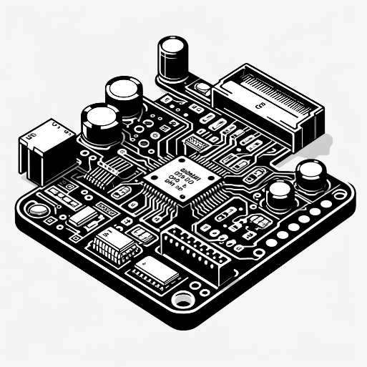
Two Parts Testing System
Test station
Tested on-board computer
User Interface
Test Creation and Management
Results Management
Database
Running tests
Running the algorithms
Testing runtime
1
2
3
4
5
6
7
8
Introduction
Background
Algorithms
Goals
Solution
Challenges
Verification & Testing System
User interface
15
15

Slide 16
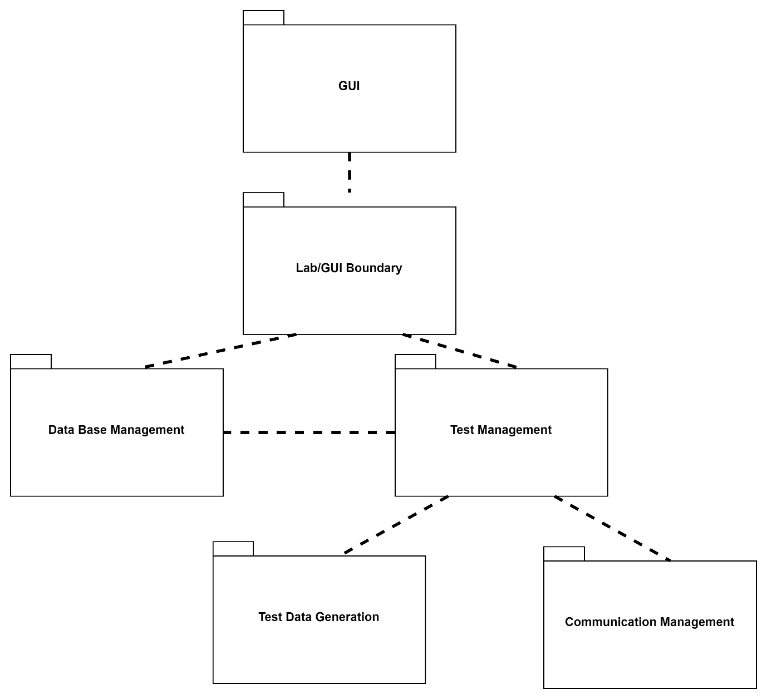
Two Parts Testing System
Test station
Tested on-board computer
1
2
3
4
5
6
7
8
16
Introduction
Background
Algorithms
Goals
Solution
Challenges
Verification & Testing System
User interface
16

Slide 17
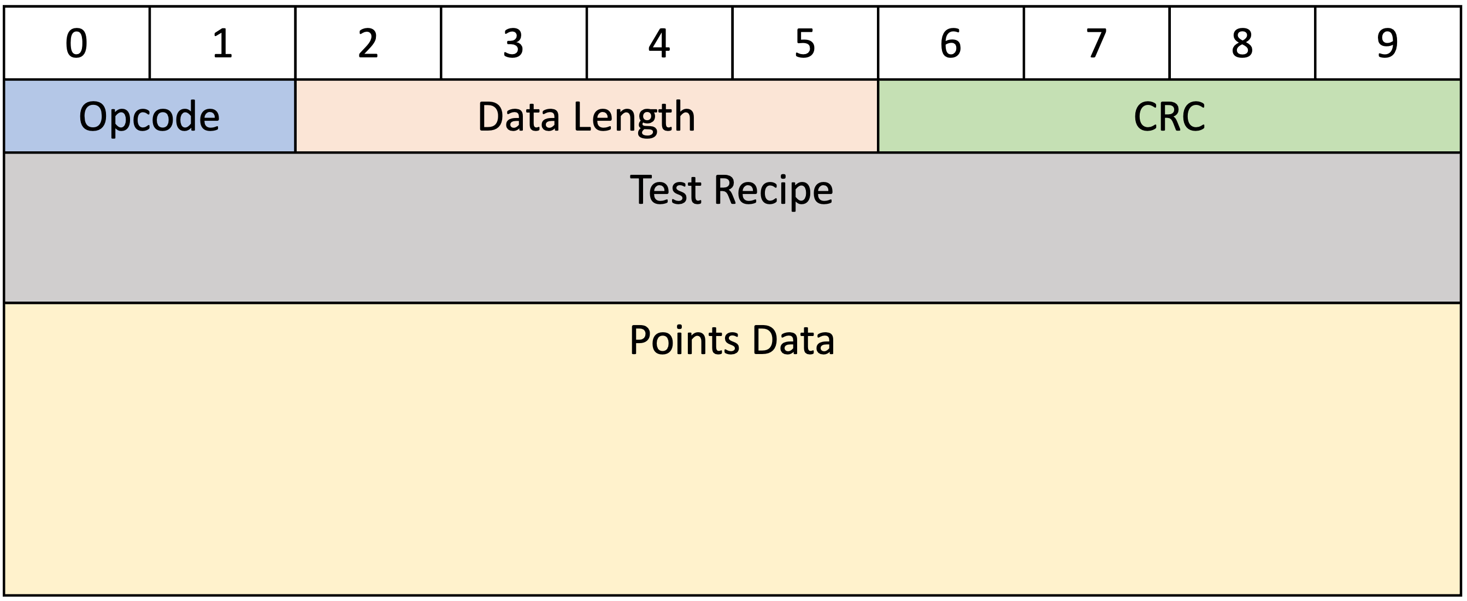
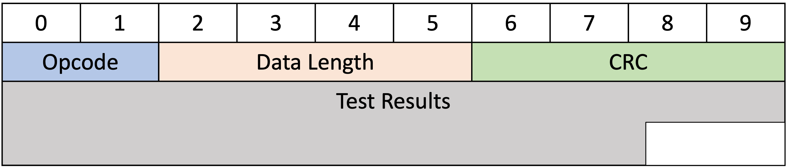

Testing System Communication
Test Request Message Description
Master-Slave architecture: Testing Station App sends requests, Tested OBC responds.
Defining a communication protocol
Error detection - CRC
Two message types: Test Request Message (from Testing Station to OBC) and Test Results Message (from OBC to Testing Station).
Test Results Message Description.
1
2
3
4
5
6
7
8
Introduction
Background
Algorithms
Goals
Solution
Challenges
Verification & Testing System
User interface
17
17

Slide 18
Communication Methods
Test Request Message Description
UDP: Fast but unreliable, lacks message order guarantees, requires manual error handling.
Cross Platform TCP: Reliable, ensures correct message order and error-free transmission, used for testing station communication.
Local simulation: Runs independently on a single machine, simulating both the Testing Station and Tested OBC for debugging and testing without actual network communication.
Test Results Message Description.
1
2
3
4
5
6
7
8
Introduction
Background
Algorithms
Goals
Solution
Challenges
Verification & Testing System
User interface
18
18

Slide 19
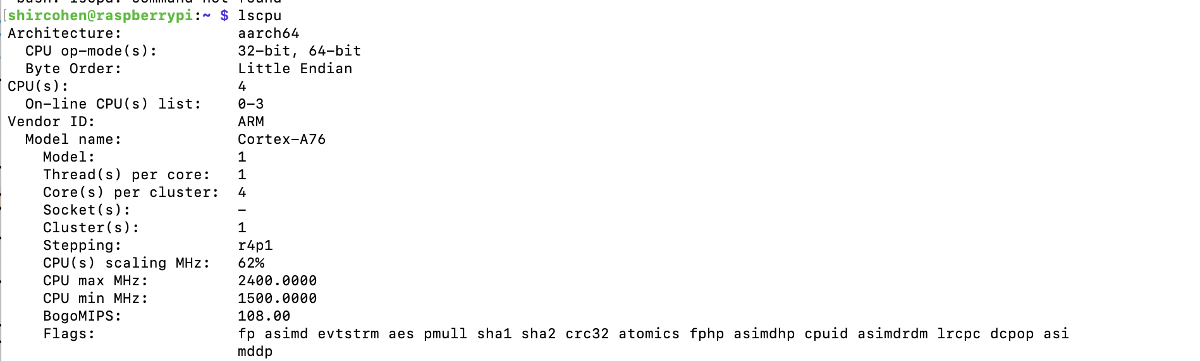
Testing System Environments
Windows,MacOS, Linux on Raspberry Pi 5
TCP/UDP over localhost, when both systems operate on the same machine.
TCP/UDP over Wi-Fi, when the systems operate on the diffrent machines.
Local Simulation Mode: Simulates communication within the Tested OBC App, enabling test execution without a network connection, supporting asynchronous and self-contained testing.
Feasibility Testing Environments:
Raspberry Pi 5 OBC with Cross Platform TCP over WIFI
CPU Specifications of the Raspberry Pi 5
1
2
3
4
5
6
7
8
Introduction
Background
Algorithms
Goals
Solution
Challenges
Verification & Testing System
User interface
19
19

Slide 20
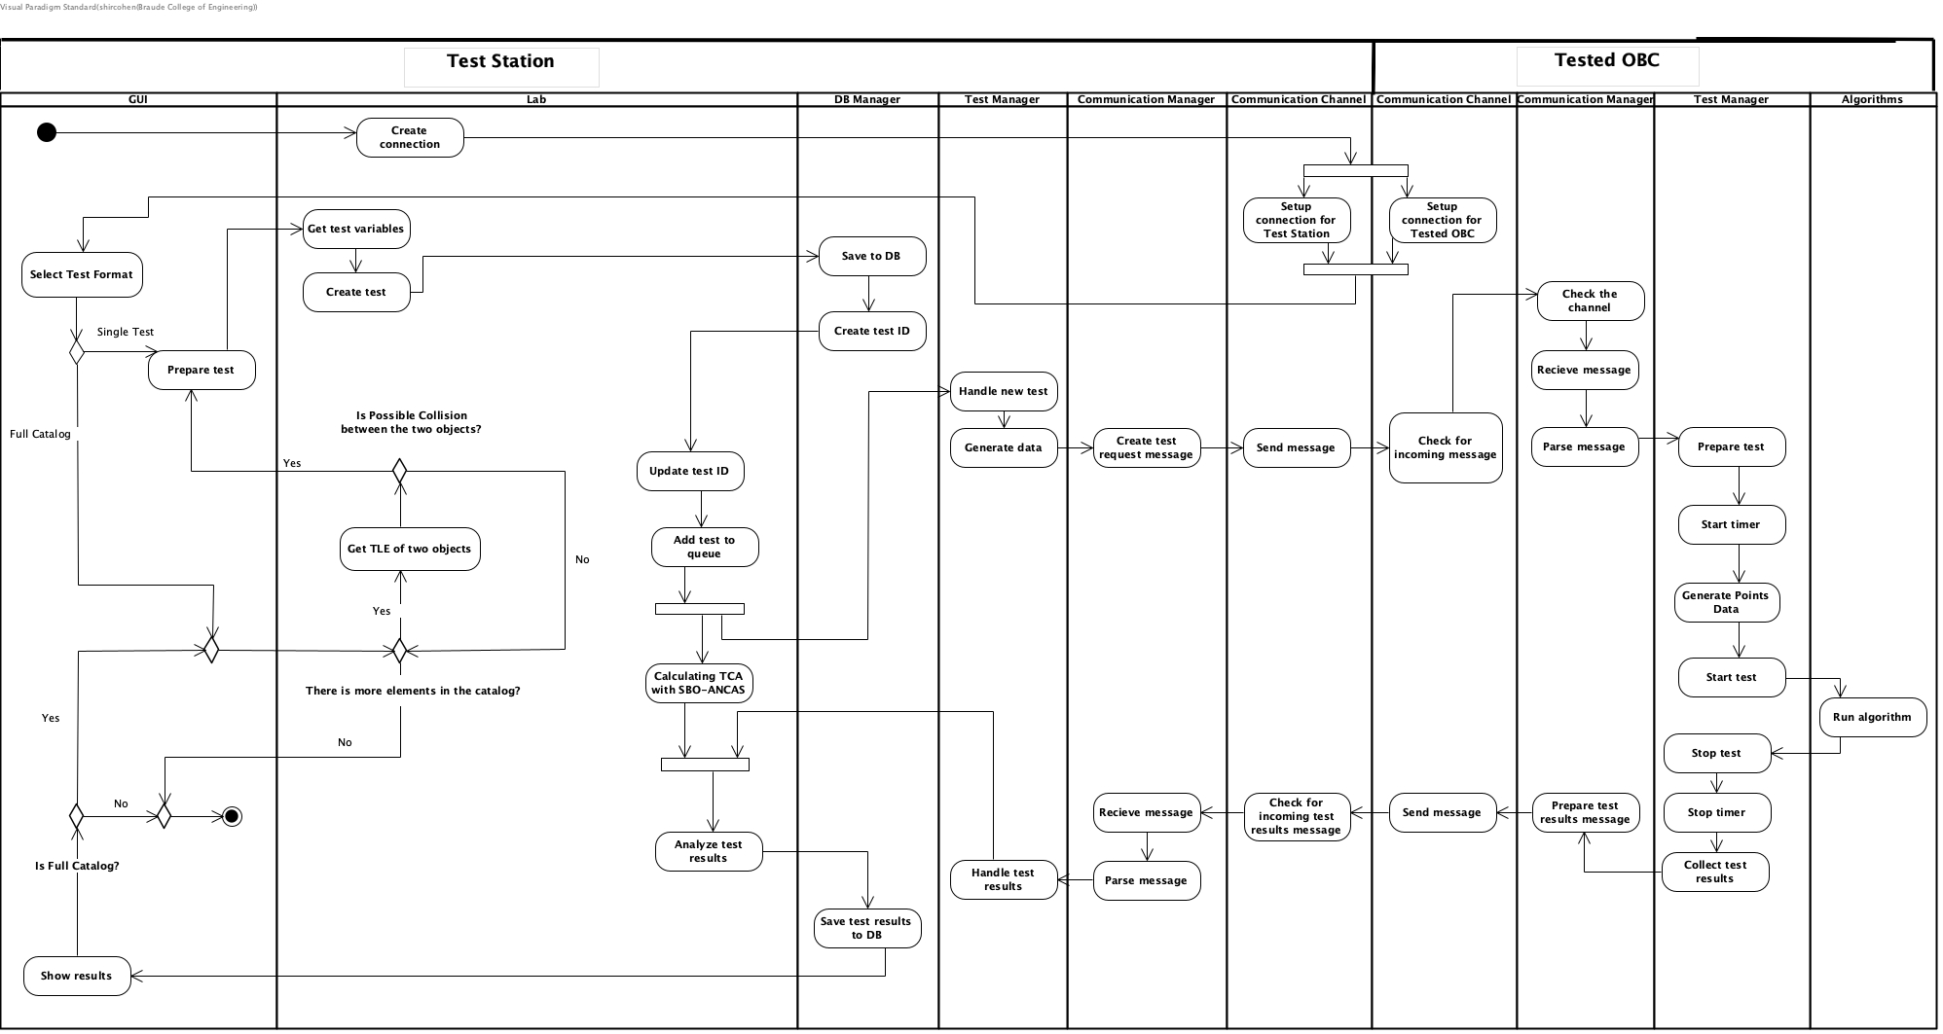
Full System Activity Diagram

Slide 21
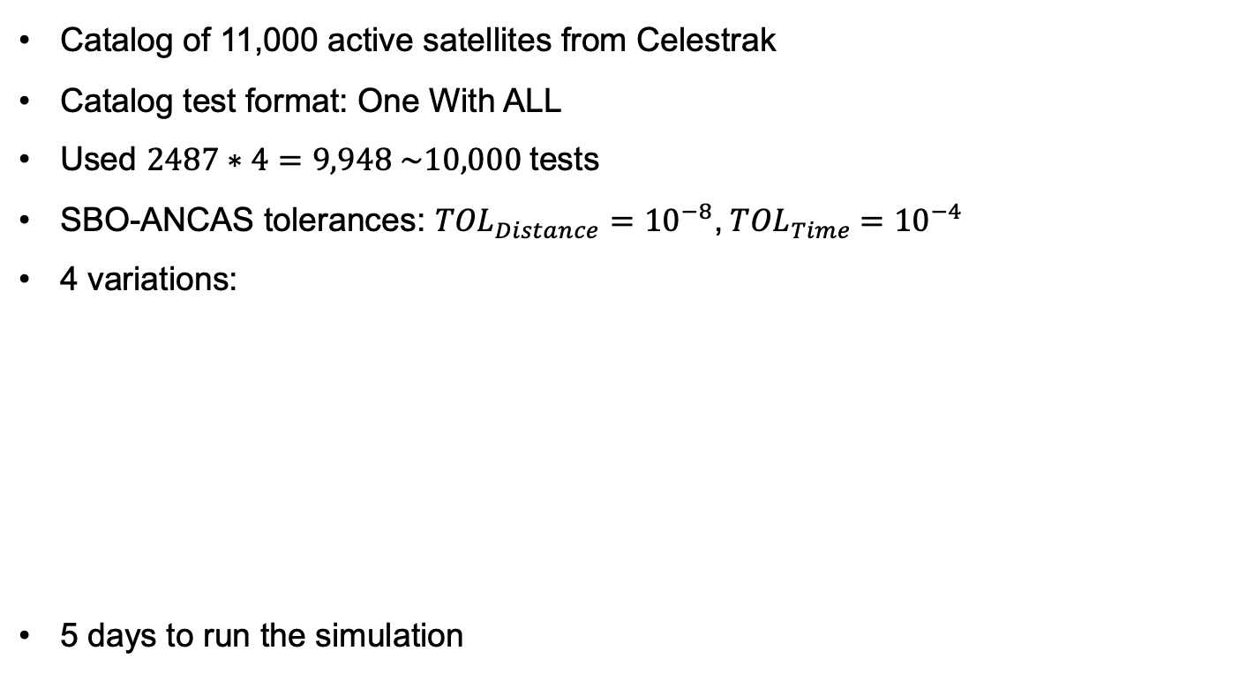
Feasibility Testing Data
Catalog of 11,000 active satellites from Celestrak
Catalog test format: One With ALL
Used $2487∗4=9,948 \sim 10,000$tests
SBO-ANCAS tolerances: ${TOL}_{Distance}={10}^{−8}$,${ TOL}_{Time} ={10}^{−4}$
4 variations:
5 days to run the simulation
version | Number of Points Per Segments | Number of segments per minimal revolution
1 | 8 | 8
2 | 8 | 16
3 | 16 | 8
4 | 16 | 16
1
2
3
4
5
6
7
8
Introduction
Background
Algorithms
Goals
Solution
Challenges
Verification & Testing System
User interface
21
21

Slide 22
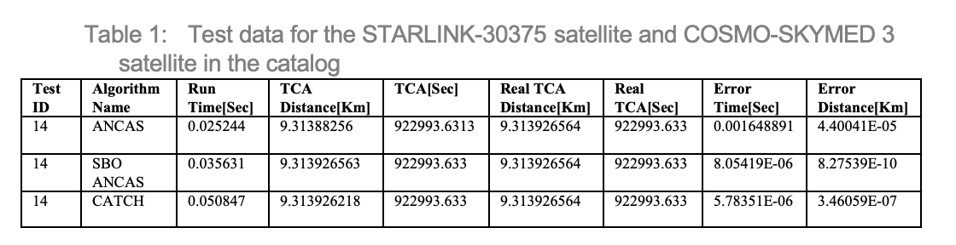
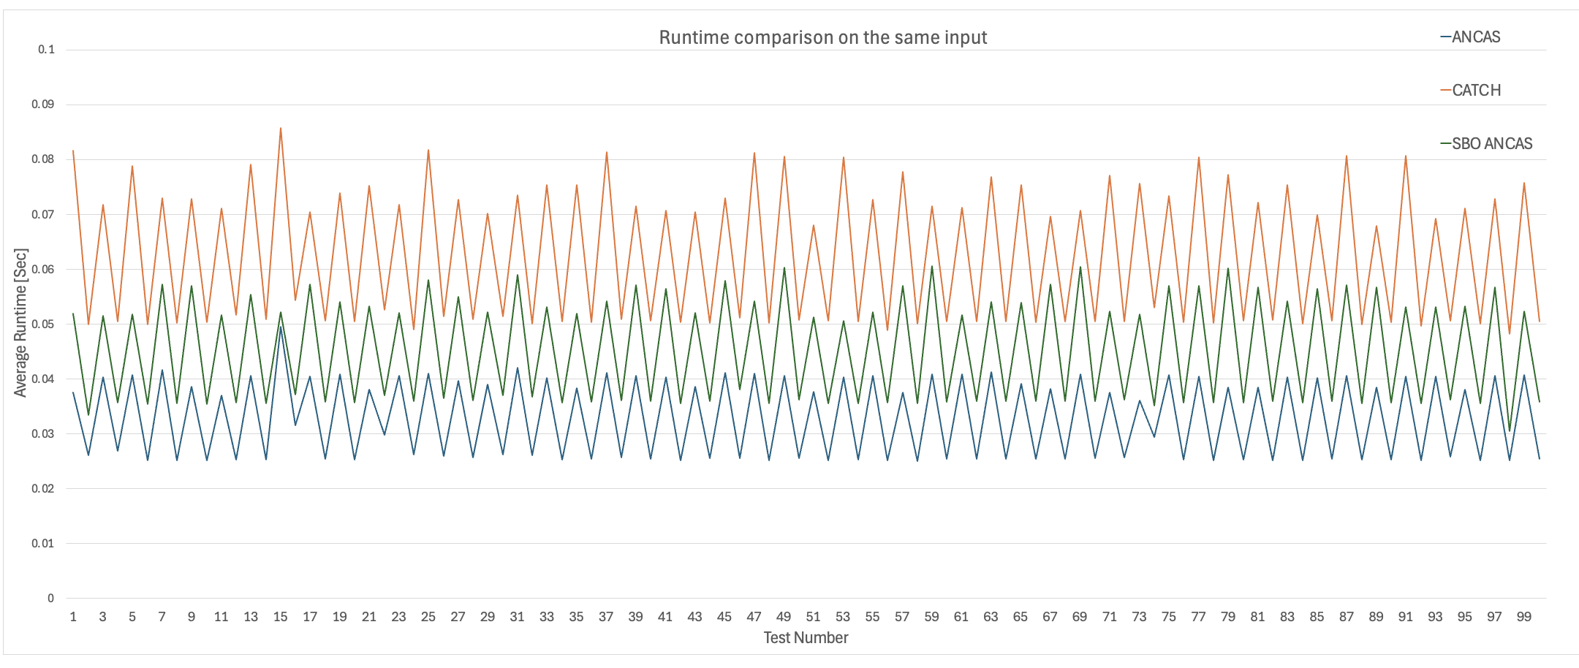
Feasibility Testing – Runtime Comparison
Algorithms Runtime [Sec] per test, only on the first 100 tests for Tmin=8 and 8 points per segment.
22
22

Slide 23
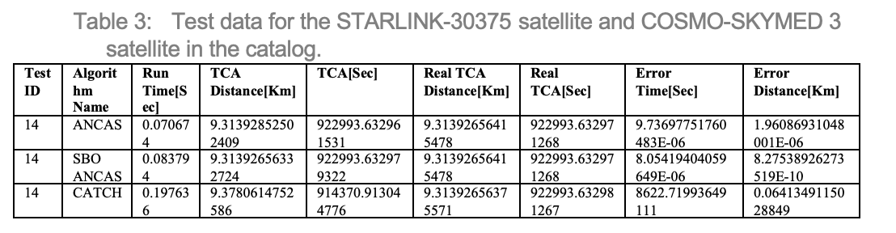
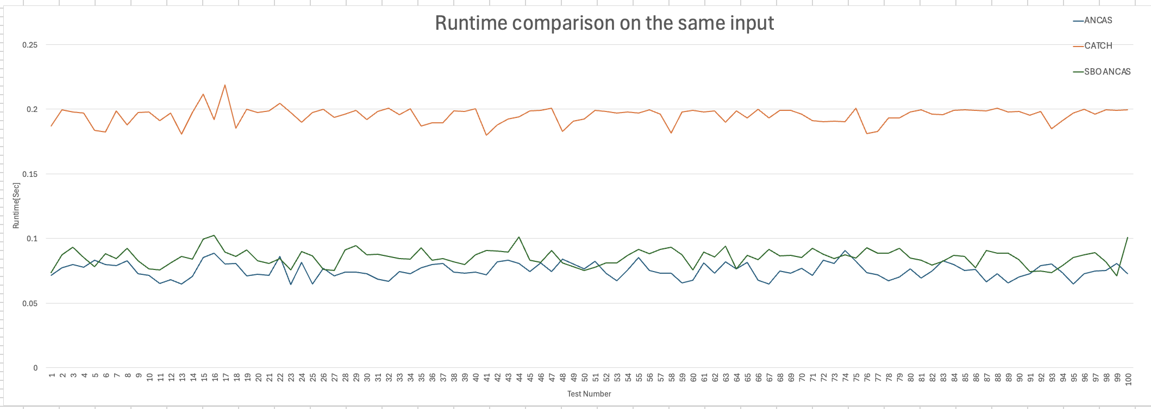
Feasibility Testing – Runtime Comparison
Algorithms Runtime [Sec] per test, only on the first 100 tests for Tmin=16 and 8 points per segment.
23
23

Slide 24
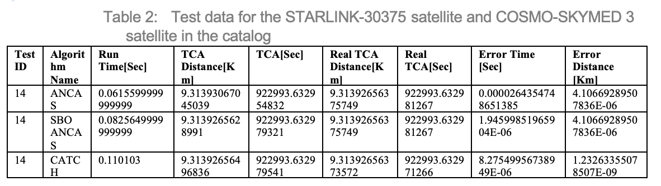
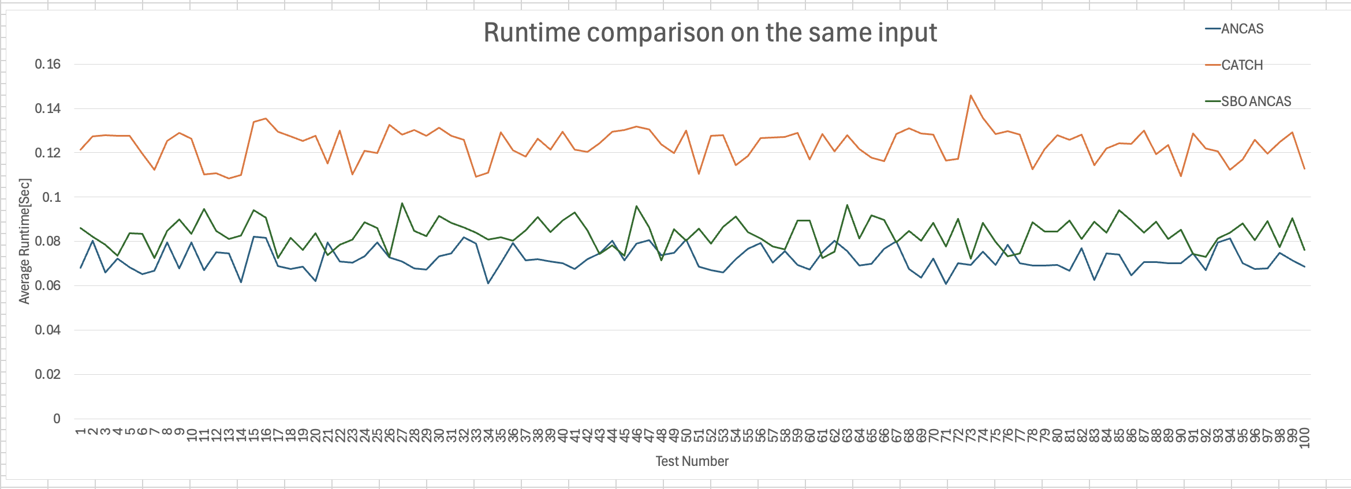
Feasibility Testing – Runtime Comparison
Algorithms Runtime [Sec] per test, only on the first 100 tests for Tmin=8 and 16 points per segment.
24
24

Slide 25
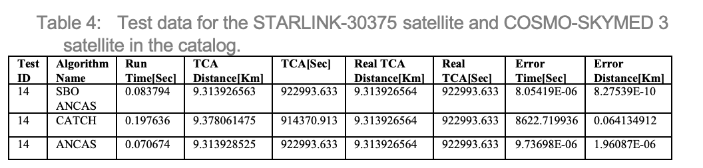
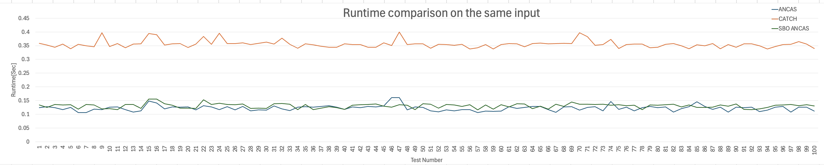
Feasibility Testing – Runtime Comparison
Agorithms Runtime [Sec] per test, only on the first 100 tests for Tmin=16 and 16 points per segment.
25
25

Slide 26
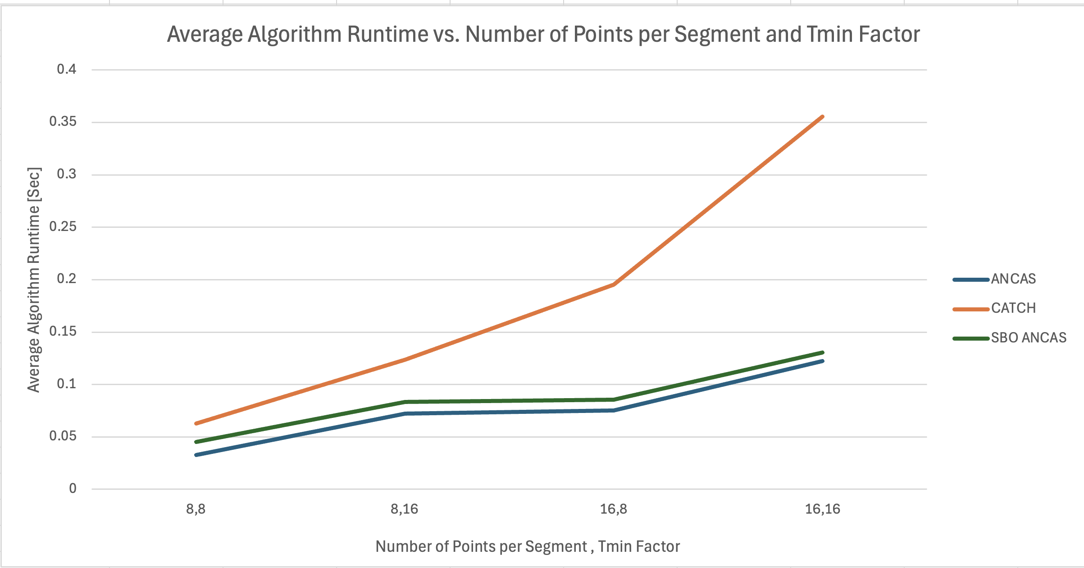
Feasibility Testing – Runtime Comparison
ANCAS: Linear growth in running times with input size.
SBO‑ANCAS: Consistent increase in run times, dependent on parameters and data characteristics.
CATCH: Steep rise in running times due to high computational costs.
26
26

Slide 27
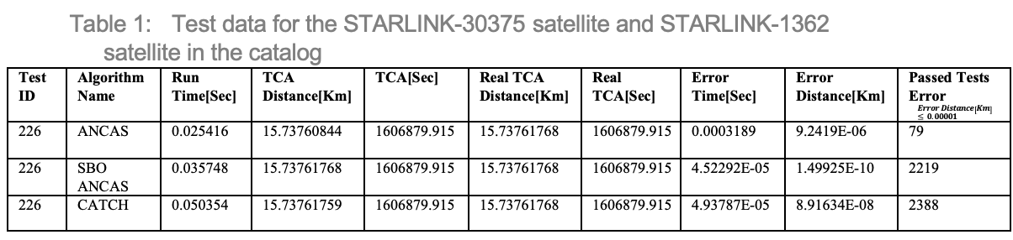
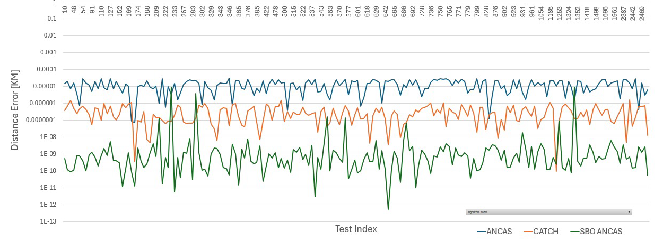
Feasibility Testing – Error Analysis
Algorithms distance error [KM] per test in logarithmic scale, only for the tests that passed the defined tolerance 0.00001 for Tmin=8 and 8 points per segment.
27
27

Slide 28
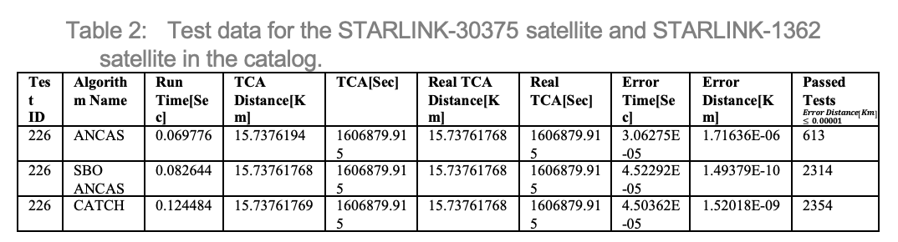
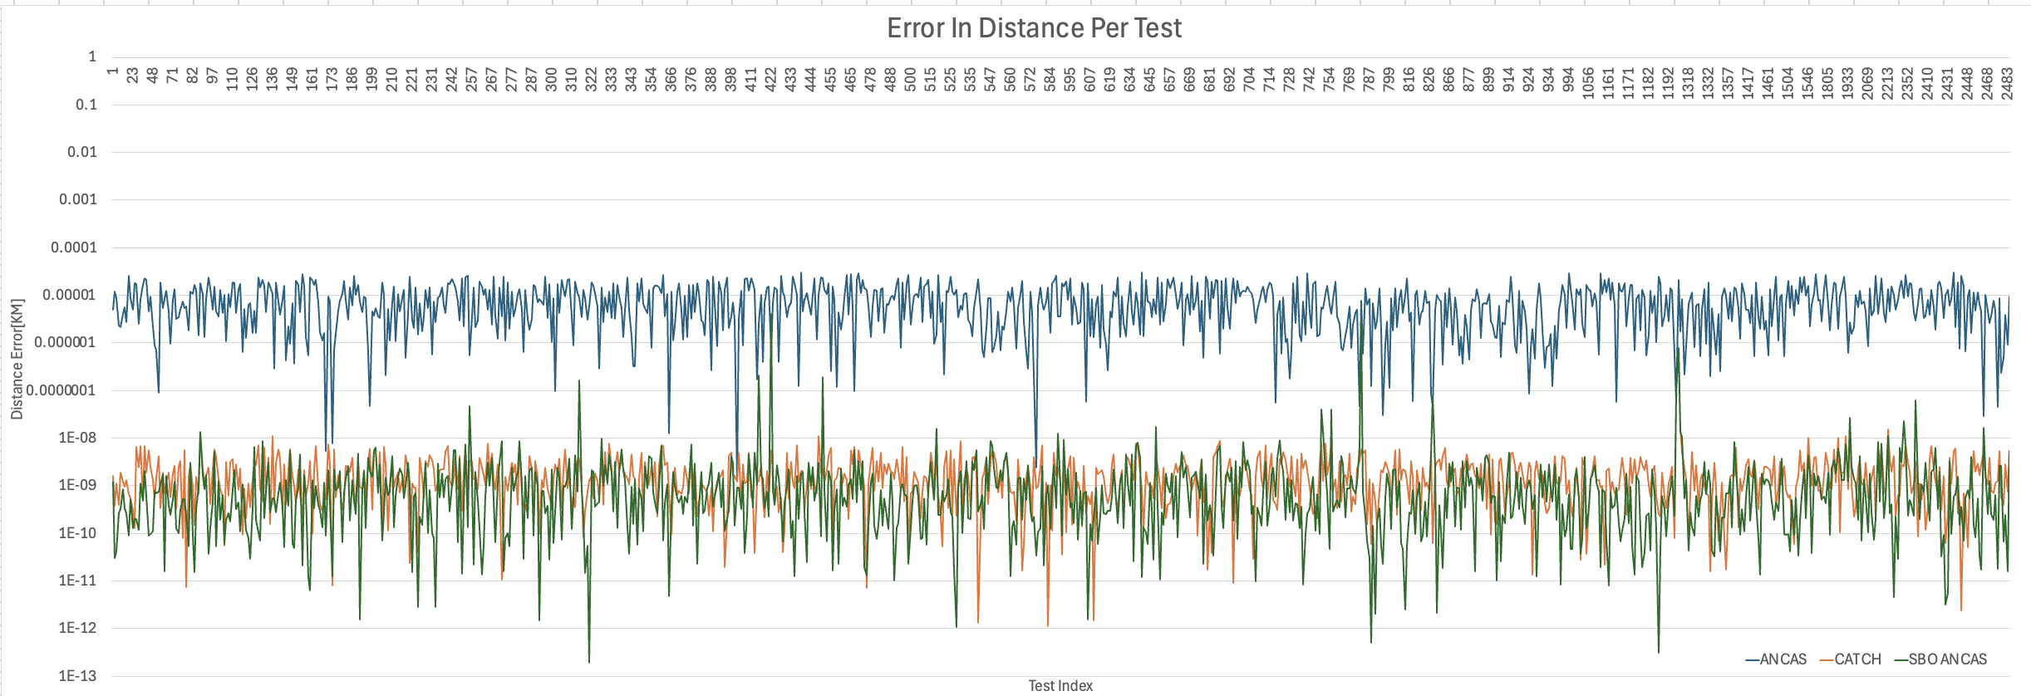
Feasibility Testing – Error Analysis
Algorithms distance error [KM] per test in logarithmic scale,only for the tests that passed the defined tolerance 0.00001 for Tmin=16 and 8 points per segment.
28
28

Slide 29
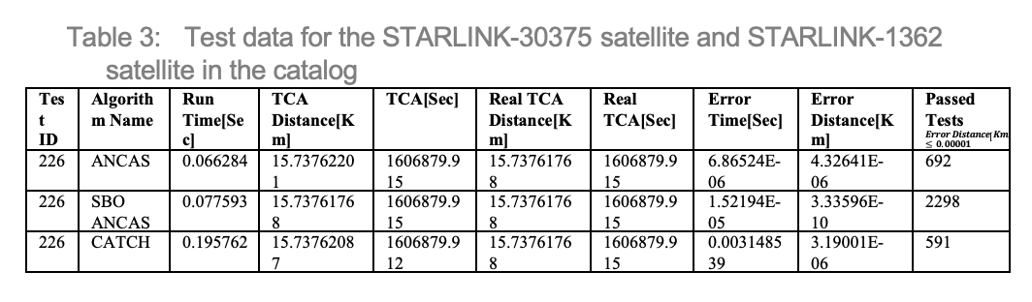
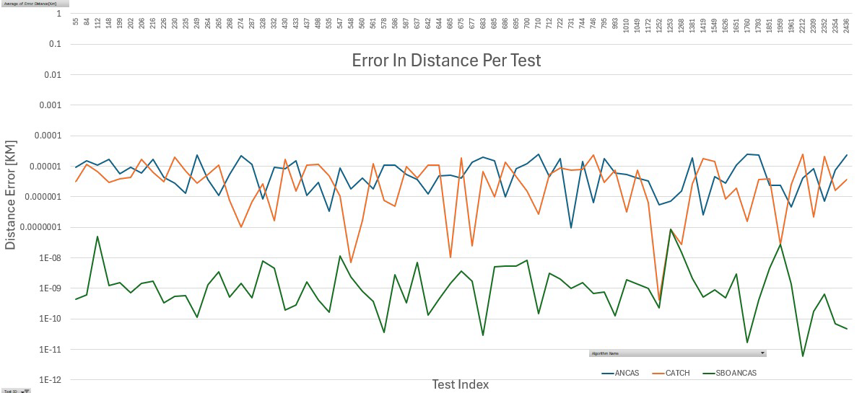
Feasibility Testing – Error Analysis
Algorithms distance error [KM] per test in logarithmic scale, only for the tests that passed the defined tolerance 0.00001 for Tmin=8 and 16 points per segment.
29
29

Slide 30
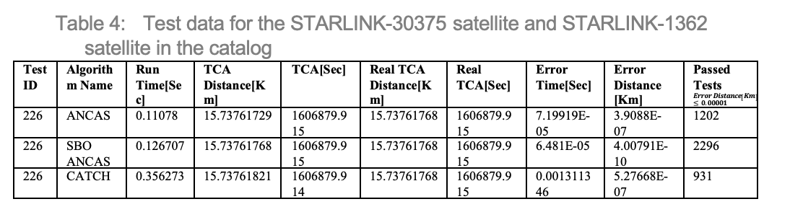
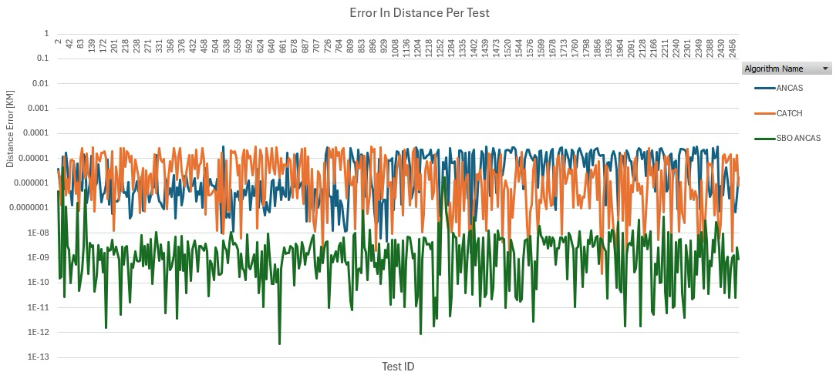
Feasibility Testing – Error Analysis
Algorithms distance error [KM] per test in logarithmic scale, only for the tests that passed the defined tolerance 0.00001 for Tmin=16 and 16 points per segment.
30
30

Slide 31
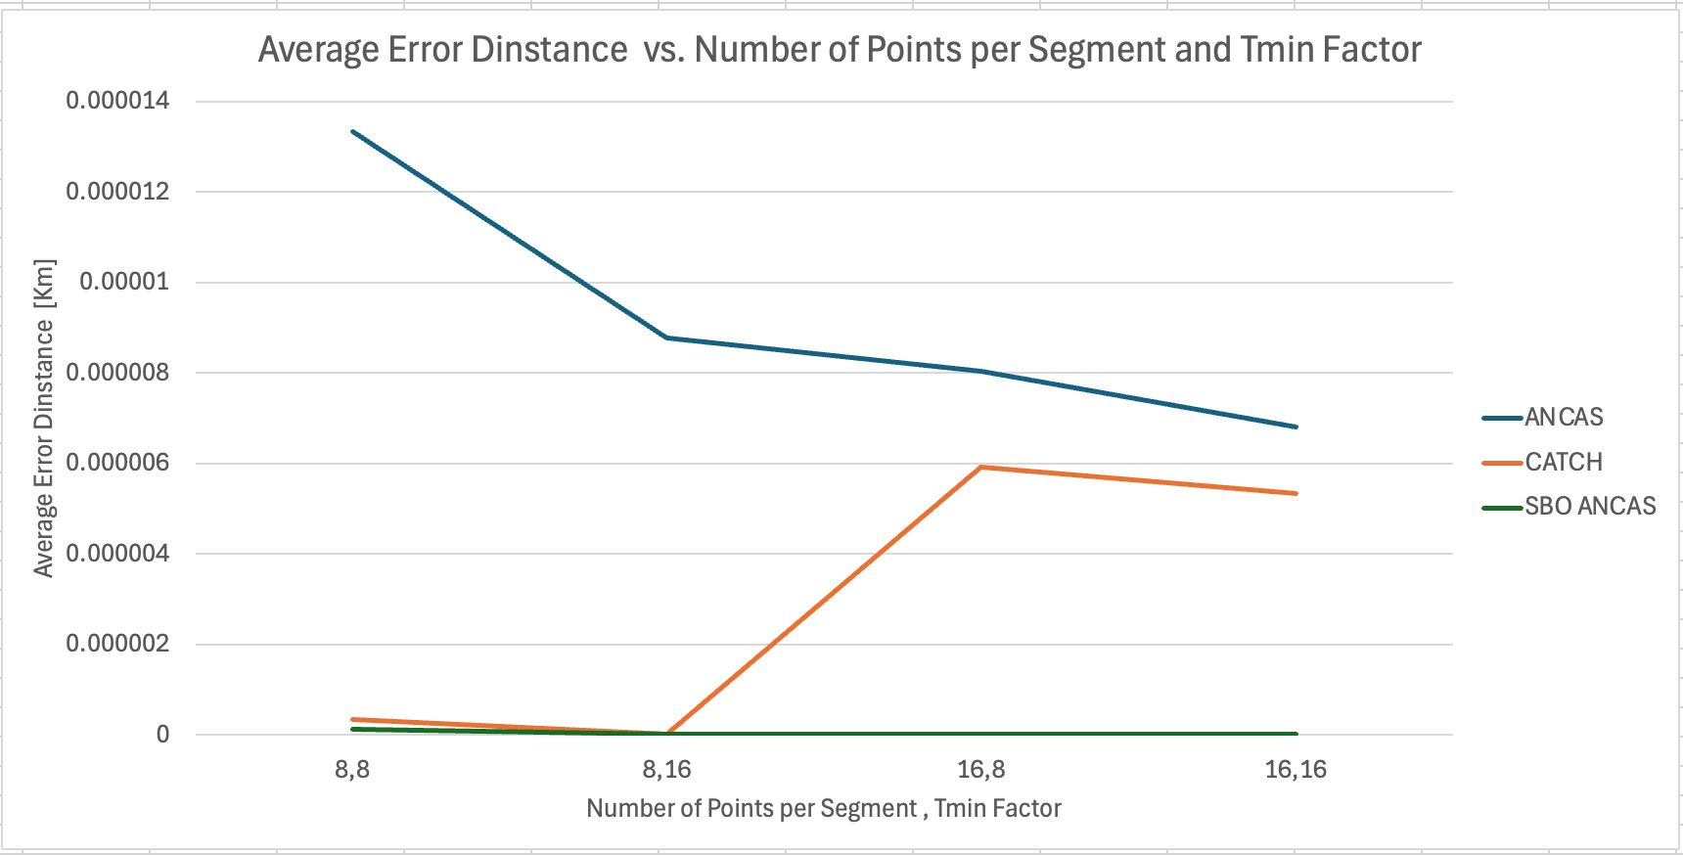
Feasibility Testing – Error Analysis
ANCAS:
Prioritizes speed but has relatively high error values in distance calculations.
SBO‑ANCAS:
Lowest error values, benefiting from iterative refinement for high accuracy.
Consistently reliable across different test conditions.
CATCH:
Medium-range errors.
Numerical stability issues due to high-degree polynomial calculations, leading to fluctuations in error values.
31
31

Slide 32
Feasibility Testing – Conclusions
ANCAS: Fastest but least accurate.
SBO-ANCAS: Best balance; consistent high accuracy with moderate runtime.
CATCH: Can reach high accuracy but shows significant runtime cost and sometimes unexpected errors (Further Investigation Needed).
SBO-ANCAS stands out as the most suitable for real-time collision detection due to its balance of speed and precision.
32
32

Slide 33
Overall Conclusions
Achievements
Implemented and analyzed three algorithms on actual OBC.
Developed a flexible testing system.
Conducted feasibility tests under various input sizes and parameters.
Created a codebase designed for scalability and future expansions.
Unresolved Points & Next Steps
CATCH Behavior: Accuracy vs. runtime conflict remains partially unexplained.
More data and tests required for deeper insight.
Future teams can build on our system to refine and expand the analysis.
33
33

Slide 34
Challenges
Developing Cross Platforms Communication
Platform-specific implementations.
“#ifdef” directive with preprocessor defines to compile the required variation each time.
Testing and debugging asynchronous Applications
Unit tests
Local Simulations
Loggers
1
2
3
4
5
6
7
8
Introduction
Background
Algorithms
Goals
Solution
Challenges
Verification & Testing System
User interface
34

Slide 35

User Interface - Video
35
1
2
3
4
5
6
7
8
Introduction
Background
Algorithms
Goals
Solution
Challenges
Verification & Testing System
User interface

Slide 36
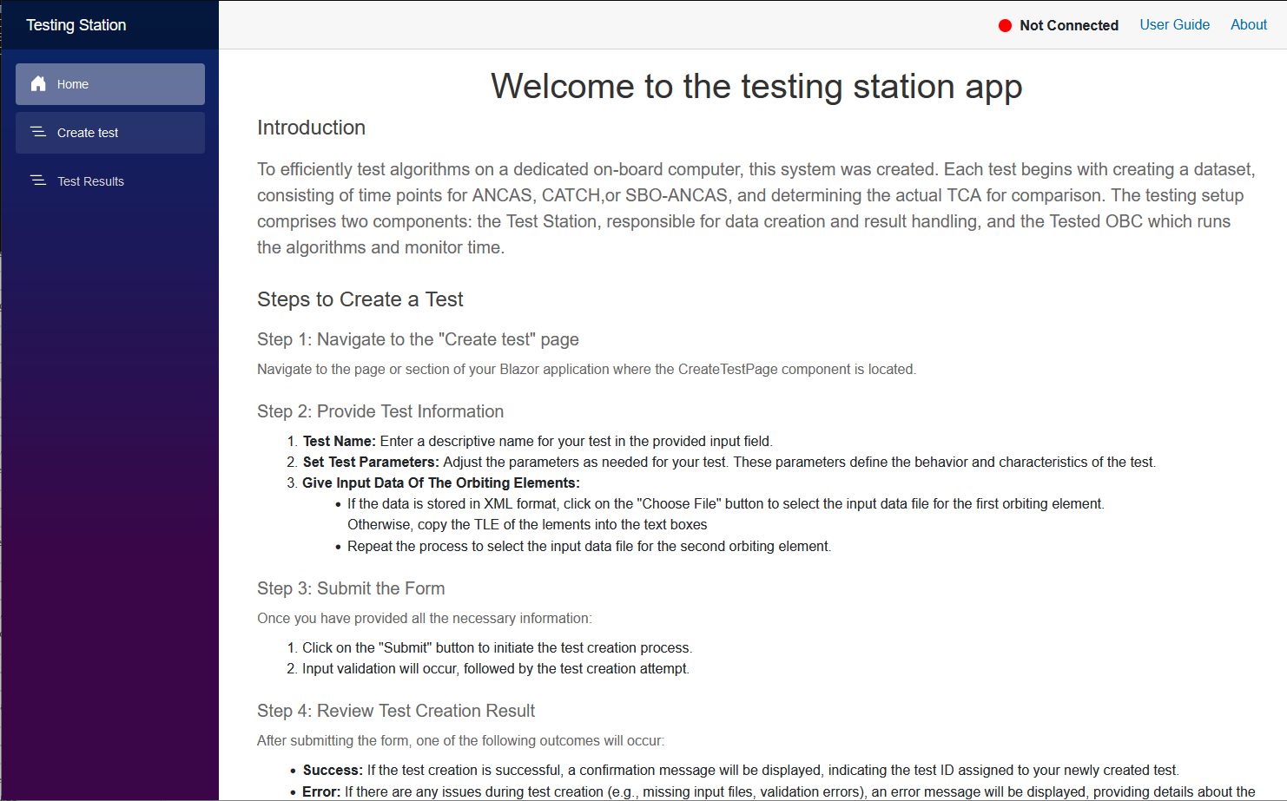
User Interface- Home Page

Slide 37
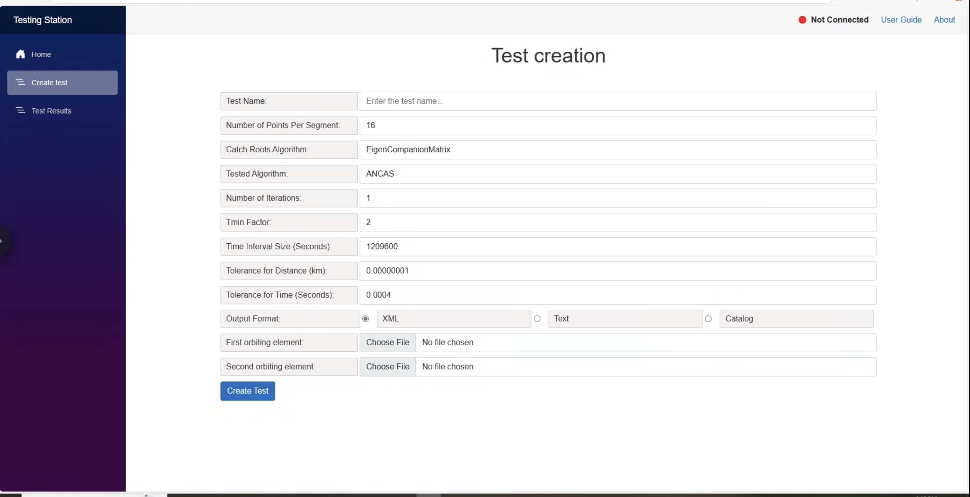
User Interface- Create Test

Slide 38
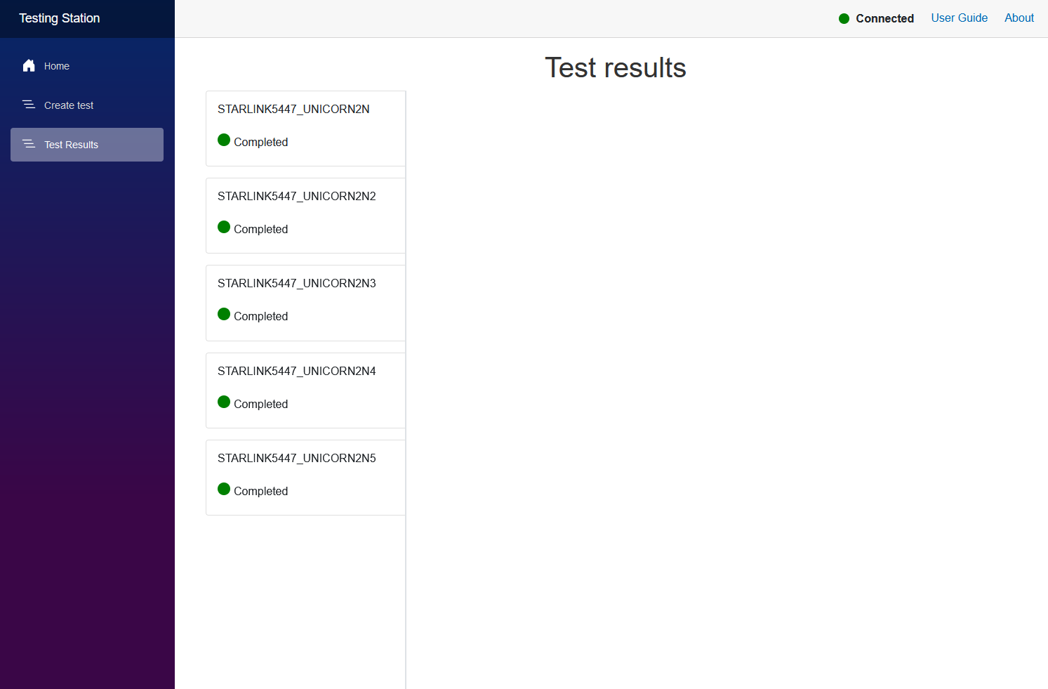
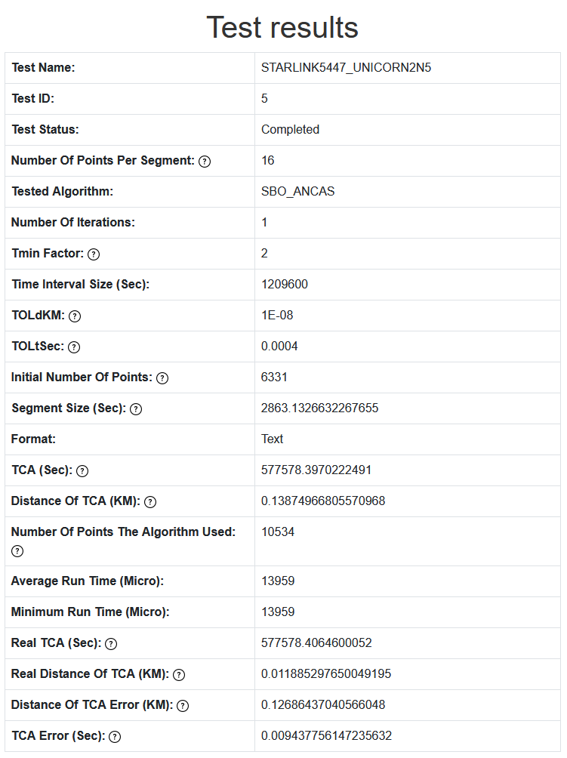
User Interface- Test Results

Slide 39
Bibliography
[1] Alfano, S. (1994). Determining Satellite Close Approaches-Part II. ADVANCES IN THE ASTRONAUTICAL SCIENCES, 87, 233 -233. ANCAS
[2] Denenberg, E. (2020). Satellite closest approach calculation through chebyshev proxy polynomials. Acta Astronautica, 170, 55-65. SBO-ANCAS
[3] Denenberg, E., & Gurfil, P. (2016). Improvements to time of closest approach calculation. Journal of Guidance, Control, and Dynamics, 39(9), 1967-1979. CATCH
[4] AstariaGraph satellites and space debris visual map : http://astria.tacc.utexas.edu/AstriaGraph/
[5] CelesTrak: https://celestrak.org/
[6] CelesTrak Current Data: https://celestrak.org/NORAD/elements/index.php?FORMAT=tle
[7] The gem5 simulator: https://www.gem5.org/
[8] ISISPACE OBC: https://www.isispace.nl/product/on-board-computer/
[9] NASA on orbital debris: NASA
[10] Our GitHub repository: https://github.com/cohensh96/Satellite-s-project
1
2
3
4
5
6
7
8
Introduction
Background
Algorithms
Expected results
Solution
Challenges
Verification & Testing System
User interface

Slide 40
Thank You!
Do you have any questions?

